Slide 1
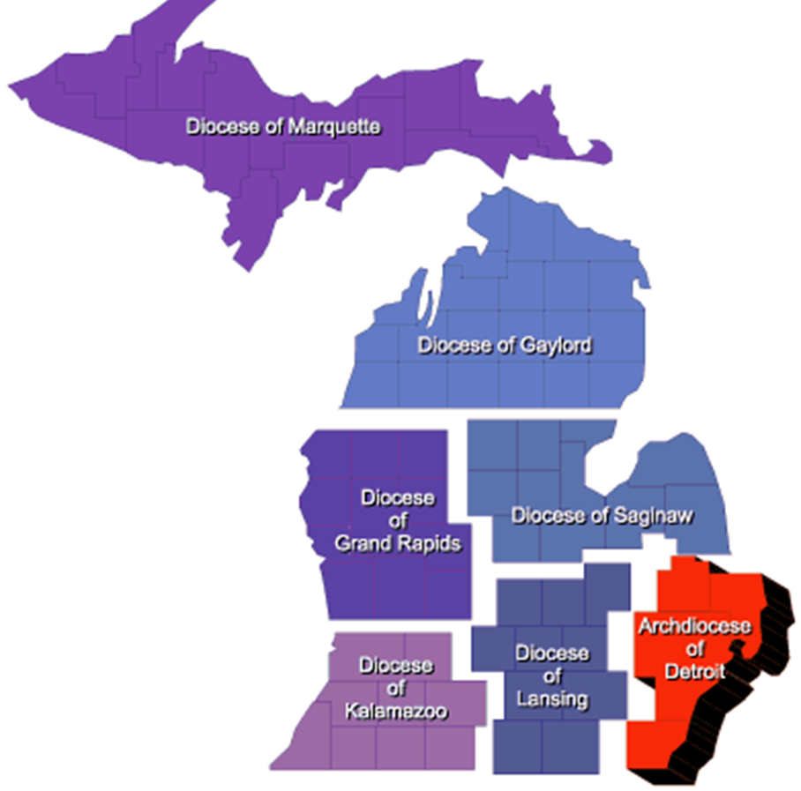
“Rise up and Answer the Call” Incentives & Recognition 2021 - 2022
State Membership Director
Dan Fuller
Celebrating those that answer the call!

Slide 2
Supreme Sponsored Incentives
District Deputies will be able to earn
Medallions depicting each of the 4 principles of our Order
Knight Gear apparel
Special Blessed Michael McGivney medallion
Win a trip to the Supreme Convention
Michigan will be compete against other Jurisdictions in growth during July, August and September to win CA$H
Michigan will win $upreme Prize$ that will be use for Incentives

Slide 3
QUARTERLY INCENTIVES FOR DISTRICT DEPUTIES
Q1 (July 1 through September 30)
Every DD that attains 30% or better of District Intake Goal by September 30 receives a custom Knights of Columbus polo shirt and a coin/medallion depicting the principle of charity
Q2 (October 1 through December 31)
Every DD that attains 70% or better of District Intake Goal by December 31 receives a custom Knights of Columbus jacket and a coin/medallion depicting the principle of unity
Q3 (January 1 through March 31)
Every DD that attains 100% or more of District Intake Goal by March 31, 2022 receives a custom Knights of Columbus dress shirt and tie and a coin/medallion depicting the principle of fraternity.

Slide 4
Continued – DD Incentives
Q4 (June 30)
Every DD that attains Star District receives a Knights of Columbus watch and a coin/medallion depicting the principle of patriotism
Every DD that qualifies for all four quarterly incentives
Receives a display box containing the coins/medallions depicting charity, unity, fraternity & patriotism
Plus a special Blessed Michael McGivney coin/medallion in the center.
Additionally, the names of all qualifying district deputies will be entered in a drawing for a trip to the 2022 Supreme Convention for him and his wife, including travel, lodging and tickets to the States Dinner

Slide 5
New: Council of the Month by Region
Forms are up to date – 185, 365, 10784, Audits
Highest membership growth/month
Councils Exemplification Team
Selection team is SDRR with Diocese Directors
Certificate and refreshments presented by SDRR or Directors at the next council meeting
Council of the Month
Monthly Council Recognition Program

Slide 6
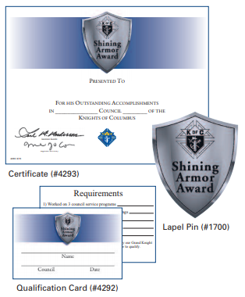
Recognition Programs
Shining Armor Program
Supreme (1 year) Obtain 3rd Degree Status
Attend 3 meetings
Volunteer 3 time in Council Programs
Sponsor 1 new member
Meeting with Field Agent to understand fraternal benefits
State (No time frame) Obtain 3rd Degree Status
Attend 3 meetings
Volunteer 3 time in Council Programs
Sponsor 1 new member
Meeting with Field Agent to understand fraternal benefits
Council level recognition. Build a culture of growth in your District

Slide 7
Annual Recognition Programs
Quick Start recognition at the February “Tribute Banquet”
Councils, Districts, Agents & Agencies achieving >60% of goal by January 1st
Council, District, Agents & Agencies achieving 100% of goal by January 1st
Ambassador Club
2 or more members sponsored = book of State Raffle Tickets
6 or more members sponsored = special gift
12 or more members sponsored = special gift and recognition at State Convention
State Convention Recognition
Star Council delegates get priority room selections
Star Council and Districts will be recognized at Convention Banquet
Traditional recognitions of Michigan

Slide 8
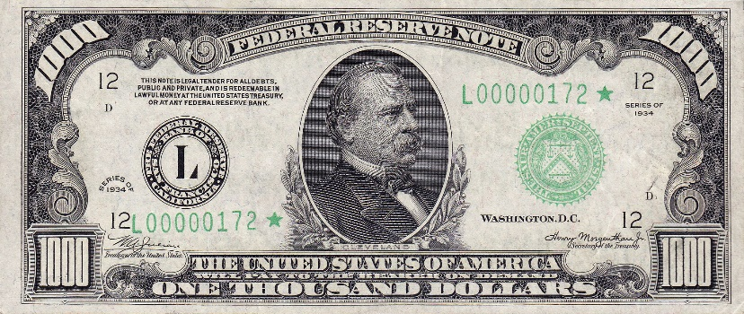
$1000 - Quarterly Membership Raffle
How to enter?
One entry for you first new member
One additional entry for the next three new members
Raffle time frame First Quarter….
July 1st to September 30th
tbd
tbd
tbd
Check will be presented to the council by our State leadership team

Slide 9
$tar Council Incentive
Every Star Council will earn a $100 per capita credit
An another $50 for each additional Star earned
Double Star $150 total
Triple Star $200 total…….

